Slide 1


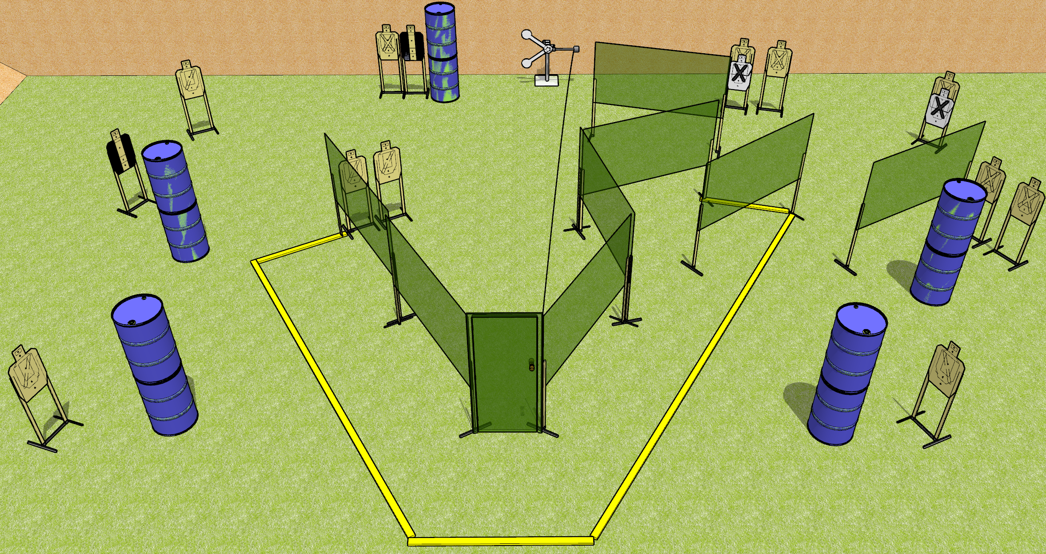
 | Dothan Gun Club – USPSA Match Brian’s Boogie Course Designer : Drew Coleman
START POSITION : Weak hand touching door handle, strong wrist below belt.
GUN READY CONDITION : Pistol loaded and holstered. PCC loaded, held with strong hand, safety on, pointed in a safe direction. |  | SCORING: Comstock, 28 rounds TARGETS: 13 paper, 2 Steel SCORED HITS: Best 2 on paper, steel until down START-STOP: Audible, last shot RULES:
STAGE PROCEDURE: Engage targets as they become available from within the fault lines.

Slide 2
Brian’s Boogie
Written Stage Briefing
Brian’s Boogie is a 28 round, 140 point, Comstock field course. There are thirteen USPSA targets and two falling plates. The best two hits on paper will score. Steel must fall to score. The start signal is audible.
Handgun start position is in the shooting area with weak hand touching door handle. Handgun is loaded and holstered.
PCC start position is in the shooting area with weak hand touching door handle. Loaded carbine is held with strong hand, safety on, pointed in a safety direction.
Upon start signal, engage targets as they become available from within the shooting area. The swinging target is activated by opening the door. It may be engaged prior to activation, but must be activated before last shot fired.

